Slide 1

Face Mask Detection
Members: 111318058 許瑞元
111318130 陳冠昇
111318133 魏千竣

Slide 2
Outline
1. Motivation
2. Dataset
3. Experimental Equipment
4. Review
5. Structure
6. Result
7. Conclusion
8. Reference

Slide 3
1.
Motivation

Slide 4
Motivation
Because of the pandemic, wearing a mask has become an indispensable part of our daily life.
We use DenseNet architecture to make face mask detection more practical.
We sort the images into 3 classes:
1.mask_worn_incorrectly
2.with_mask
3.without_mask

Slide 5
2.
Dataset

Slide 6
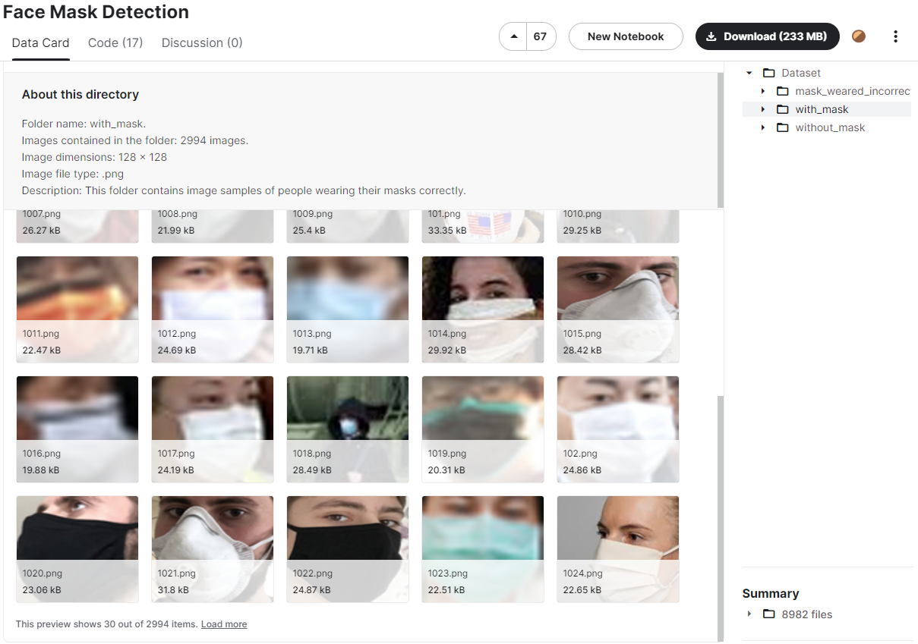
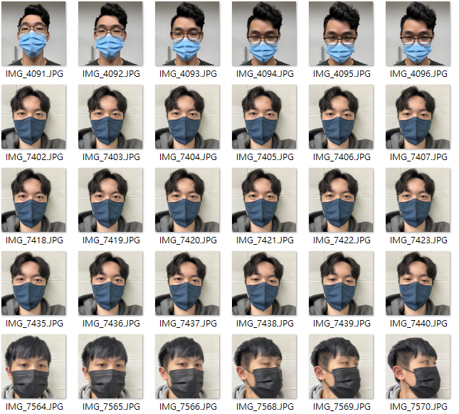
Dataset
Resources on Kaggle
Handmade dataset
8976
450
https://www.kaggle.com/datasets/vijaykumar1799/face-mask-detection

Slide 7
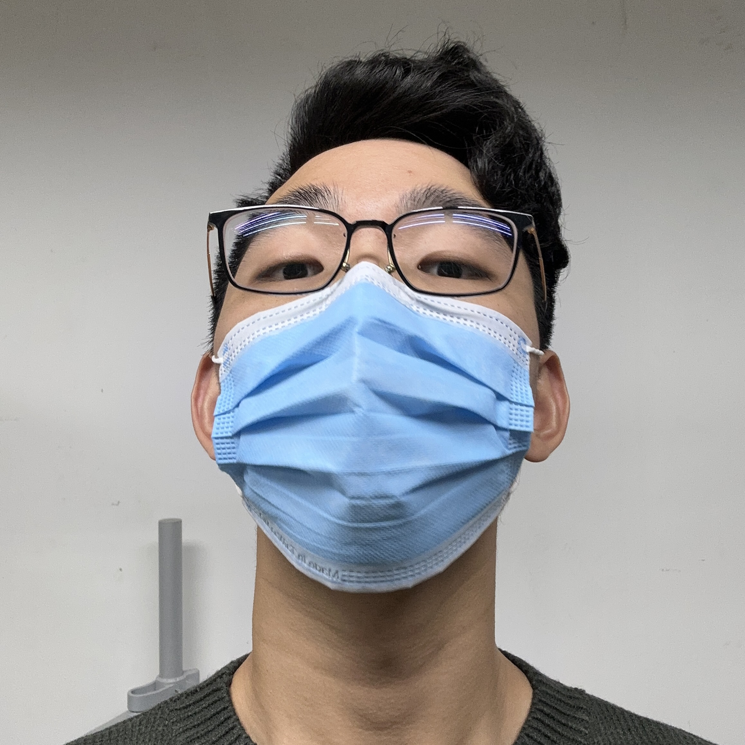
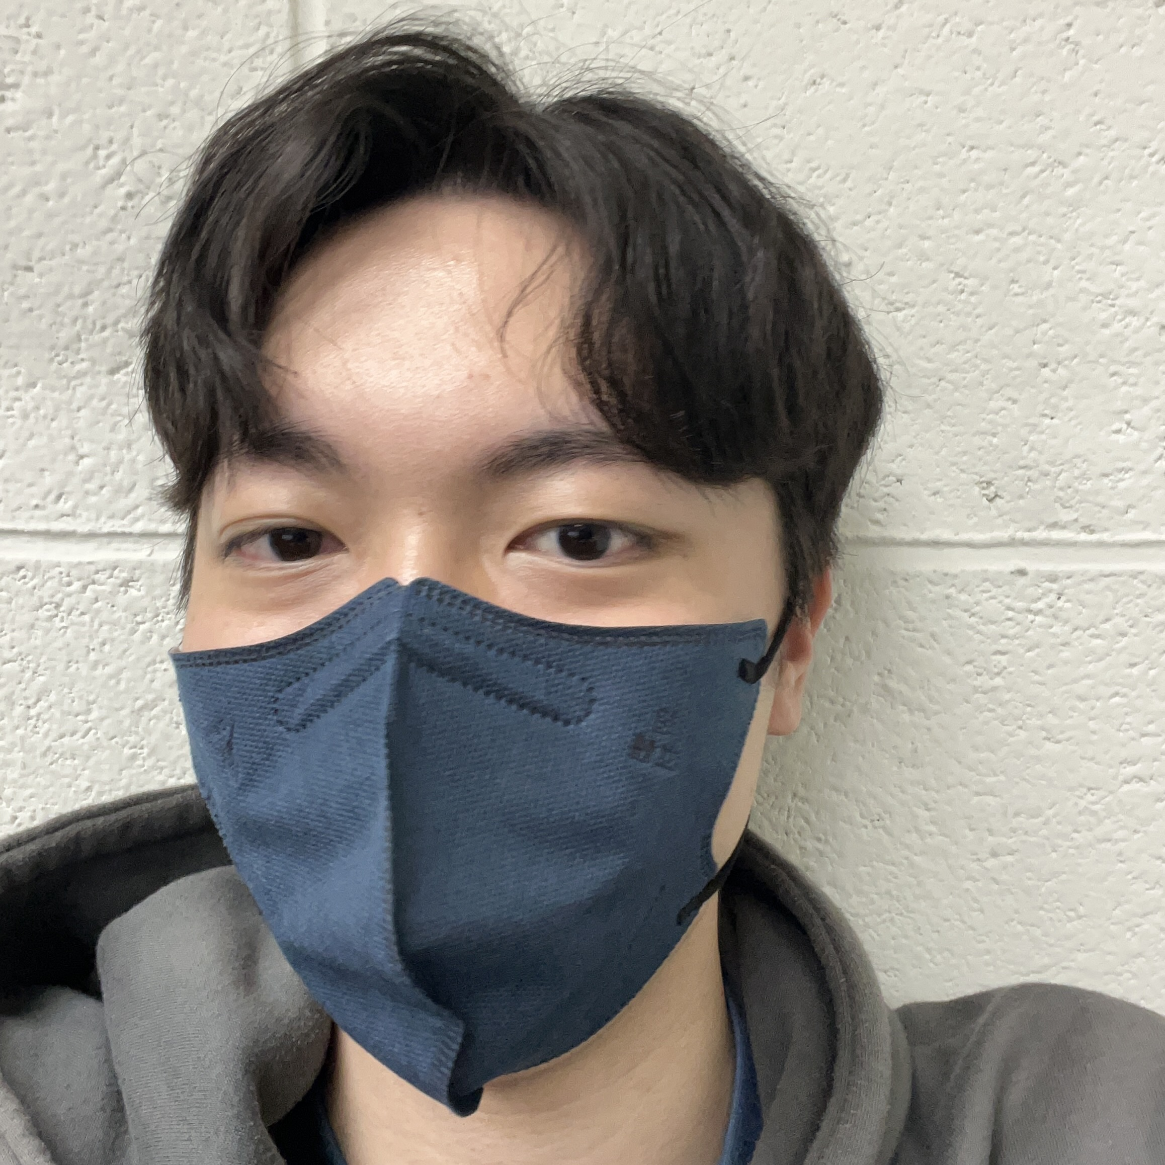
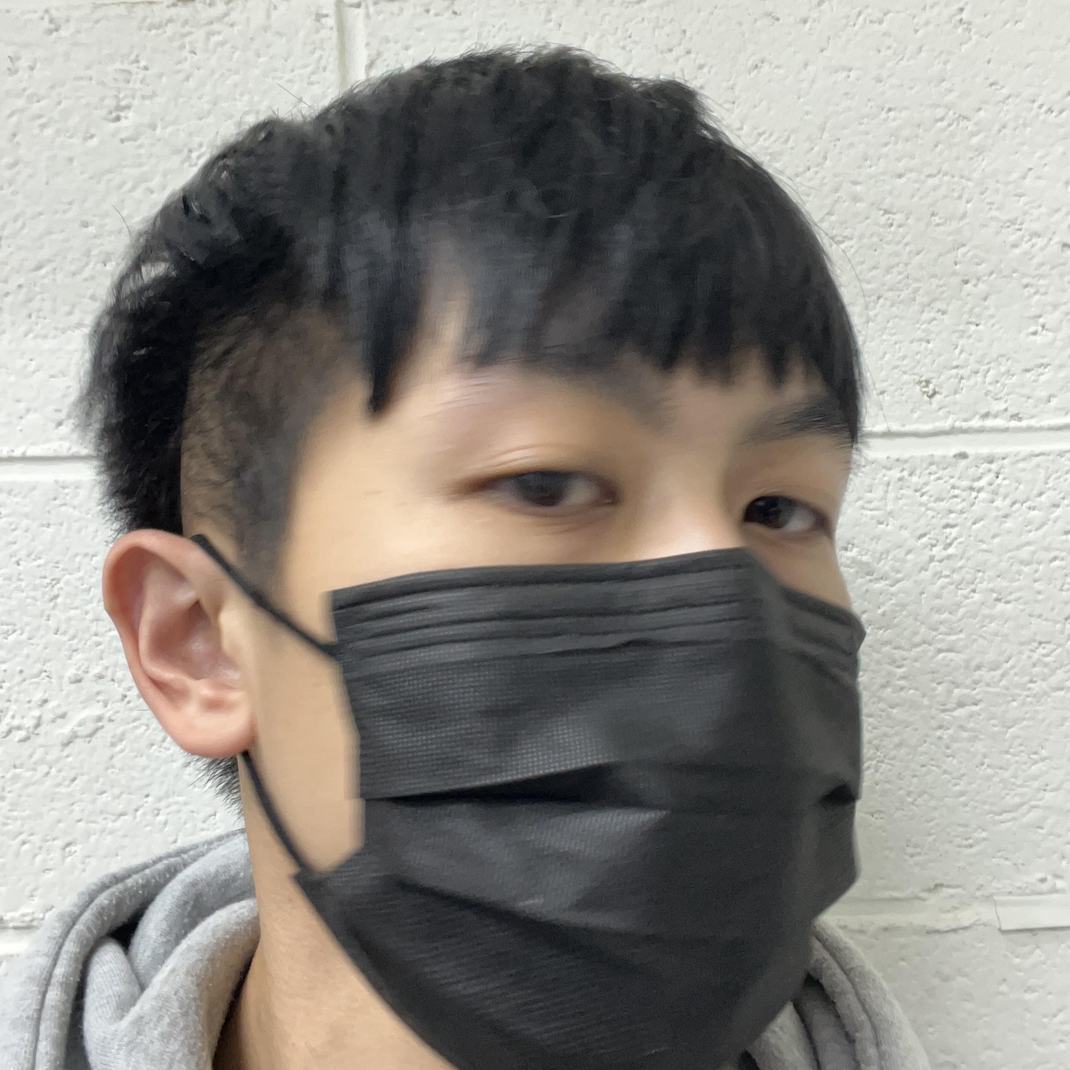

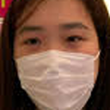
Dataset
All data
9426
Training data
Testing data
9351
75
0.8
0.2
Training
Validation
7481
1870
Image Size:28*28

Slide 8
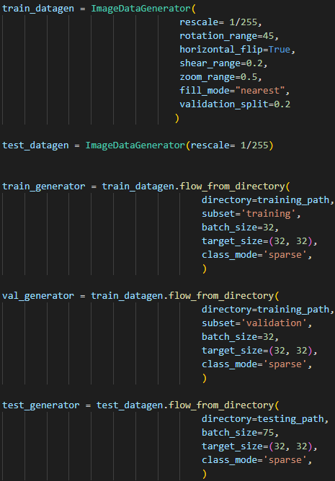
Data-Augmentation
Normalize!
rescale | convert the pixels in range [0,255] to range [0,1].
rotation range | Int. Degree range for random rotations.
horizontal_flip | Boolean. Randomly flip inputs horizontally.
shear_range | Float. Shear intensity.
zoom_range | Float or [lower, upper]. Range for random zoom. If a float, [lower, upper] = [1-zoom_range, 1+zoom_range].
fill_mode | One of {"constant", "nearest", "reflect" or "wrap"}. Default is 'nearest'.
validation_split | Float. Fraction of images reserved for validation

Slide 9
3.
Experimental Environment

Slide 10
Experimental Environment
Programming Language : Python
Interface : Visual Studio Code
CPU : i7-7700
GPU : Geforce GTX 1660 8G

Slide 11
4.
Review

Slide 12
Review-Experimental method
3 types of Model:
1.Transfer Learning DenseNet121 with ImageNet
2.Rebuild and modify DenseNet
3.Improve modified DenseNet
Same structure of fully-connected layers
Rebuild into smaller size
Improved with Depthwise Separable Convolution

Slide 13
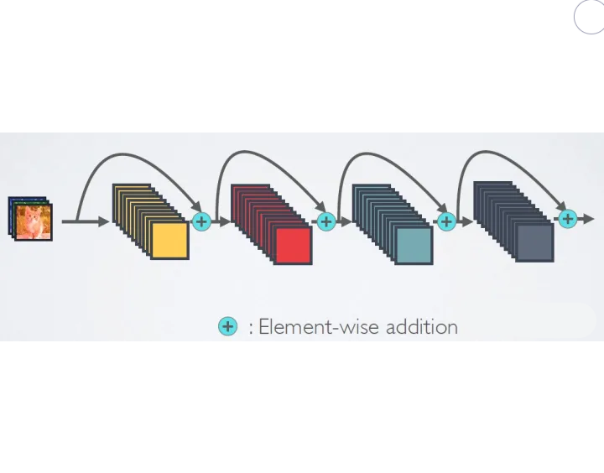
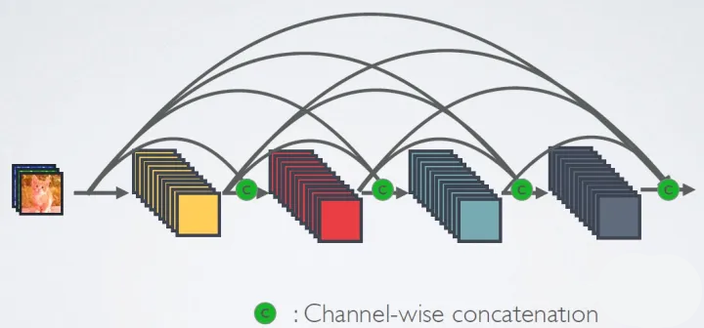
Review – Compare ResNet & DenseNet
ResNet
DenseNet
Skip connection between the front layer and the back layer
Dense connection between all the front layers and the back layers

Slide 14
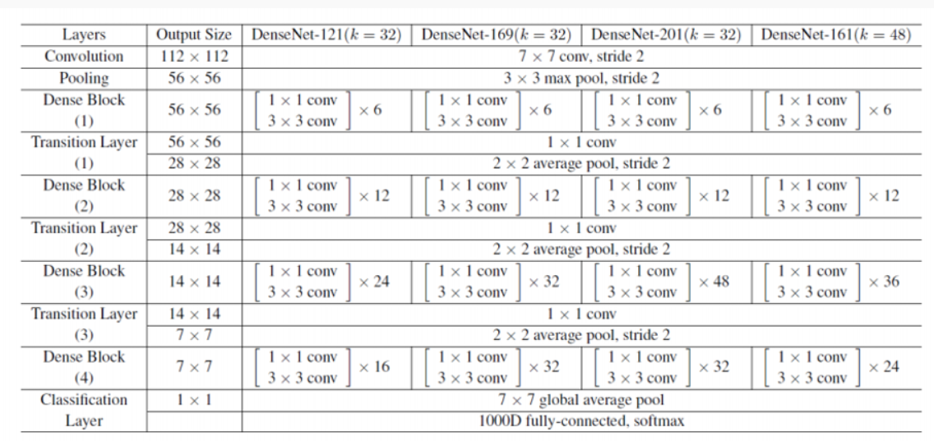
Review - DenseNet121
12
12
12
12

Slide 15
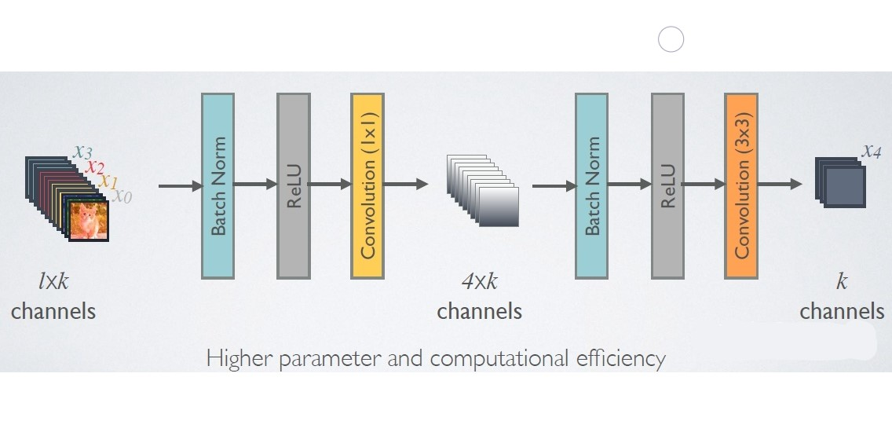
Review – DenseNet
The original DenseNet architecture is
Batch Normalization + ReLU + 3*3Conv
Each DenseBlock output k feature maps after convolution;
In other words, the number of output channels is k, aka growth rate in DenseNet

Slide 16
Review – DenseNet-BC
Due to feature reuse, the input channels of DenseBlocks will be very large.
Bottleneck layer(1*1 CONV) is added to reduce the amount of calculation.
The whole architecture is called DenseNet-B, which is shown as below:
Batch Normalization + ReLU + 1*1Conv + Batch Normalization + ReLU + 3*3Conv

Slide 17
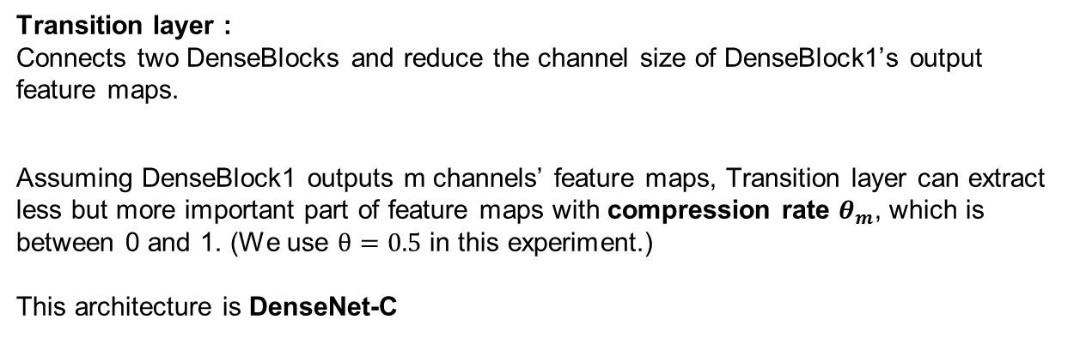
Review – DenseNet-BC
Transition layer :
Connects two DenseBlocks and reduce the channel size of DenseBlock1’s output feature maps.
Assuming DenseBlock1 outputs m channels’ feature maps, Transition layer can extract less but more important part of feature maps with compression rate $θ_{m}$, which is between 0 and 1. (We use $θ=0.5$ in this experiment.)
This architecture is DenseNet-C
Batch Normalization + ReLU + 1*1Conv + 2*2AvgPooling
DenseBlock1
Transition Layer
DenseBlock2

Slide 18
5.
Structure

Slide 19
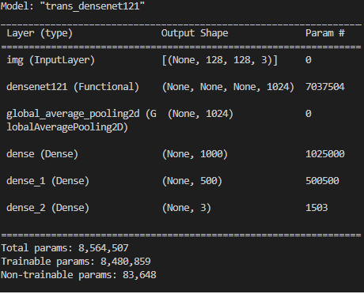
Structure1-Transfer Learning
Parameters:8,564,507
Layers: 121+2
Total Training time : 2187 sec
Same

Slide 20
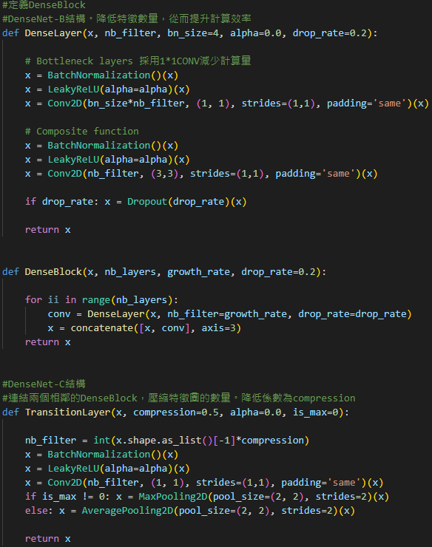
Structure2- Rebuild DenseNet-BC
Dense Layer = Bottleneck Layer + Composite Layer
DenseBlock = Dense Layer + Concatenate Layer
Transition Layer connects two DenseBlocks.
Rebuild DenseNet-BC code structure

Slide 21
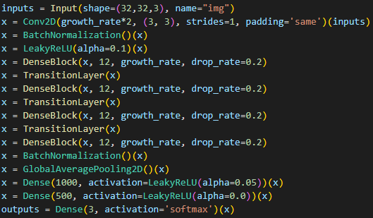
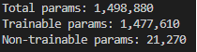
Structure2- Modified DenseNet-BC
With smaller input image size than ImageNet, we modified into smaller structure of DenseNet-BC.
Parameters: 1,498,880
Layers: 103
Total Training time: 1442 sec
Same
Modified DenseNet-BC code structure

Slide 22
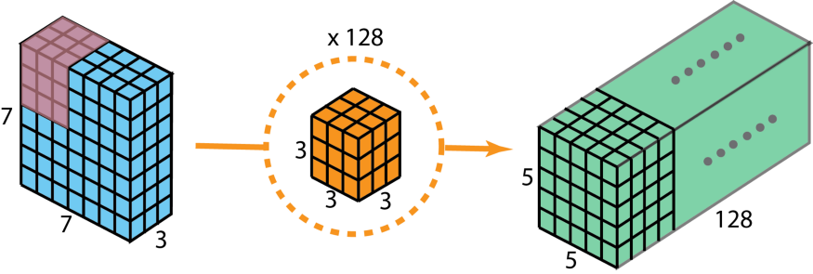
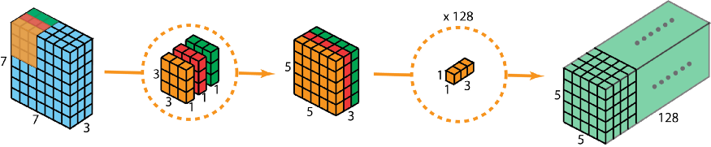
Structure3- Improved & Modified DenseNet-BC
Depthwise Separable Convolution
Compared to conventional convolution, the number of parameters used by
depthwise separable convolution can be greatly reduced with the same input and output.
The overall process of Convolution.
The overall process of Depthwise Separable Convolution.

Slide 23
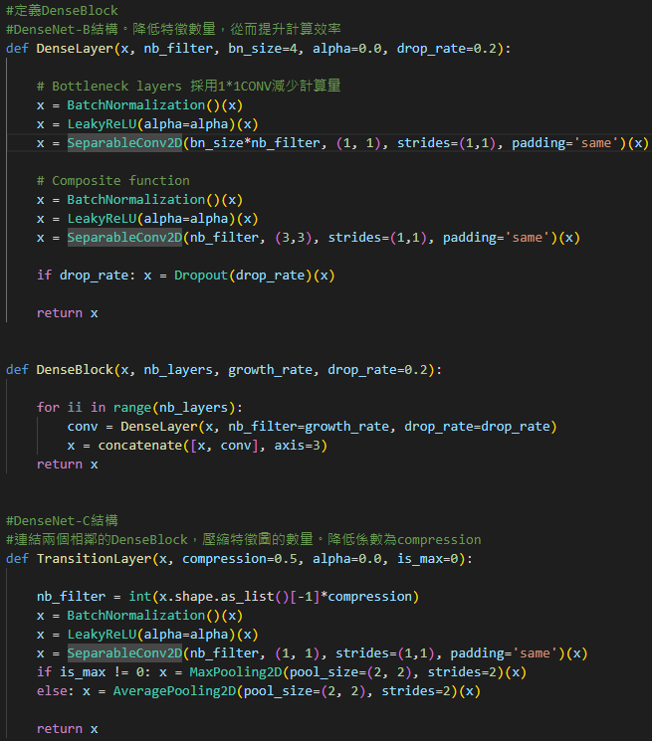
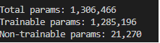
Structure3- Improved & Modified DenseNet-BC
Replacing all Conv2D with SeparableConv2D
in DenseNet-BC structure, we can get:
Parameters: 1,306,466
Layers: 103
Total Training time: 1462 sec
Improved & Modified DenseNet-BC code structure

Slide 24
Structure3- Improved & Modified DenseNet-BC
DenseNet121
-82.5%
Modified DenseNet
-84.75%
-12.8%
Improved & Modified DenseNet

Slide 25
6.
Result

Slide 26
Result – Accuracy Score
DenseNet121: 0.9866666666666667
Modified DenseNet-BC: 0.9733333333333334
Improved & Modified DenseNet-BC: 0.9866666666666667

Slide 27
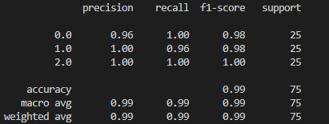
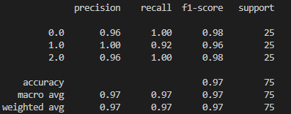
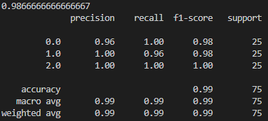
Result – Classification Report
DenseNet121
Modified DenseNet-BC
Improved & Modified DenseNet-BC

Slide 28
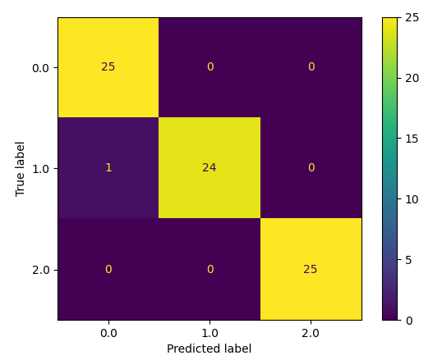
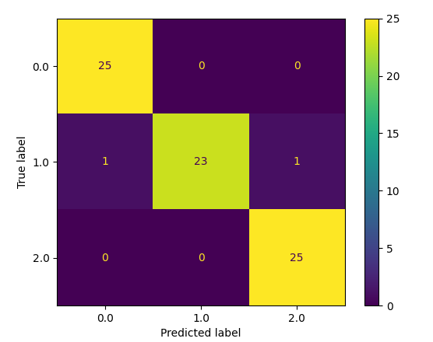
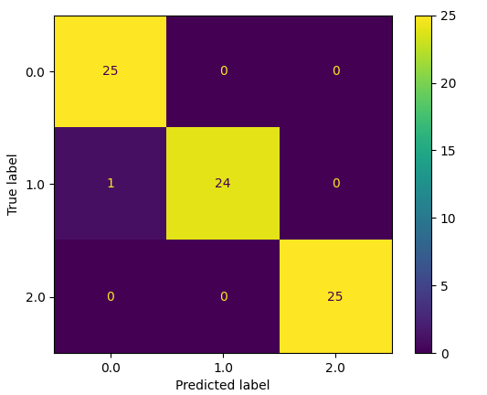
Result –Confusion Matrix
DenseNet121
Modified DenseNet-BC
Improved Modified DenseNet-BC

Slide 29
7.
Conclusion

Slide 30
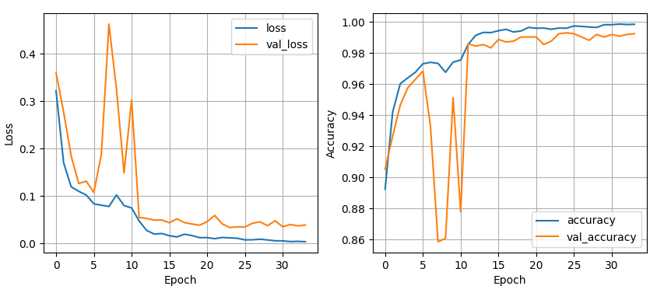
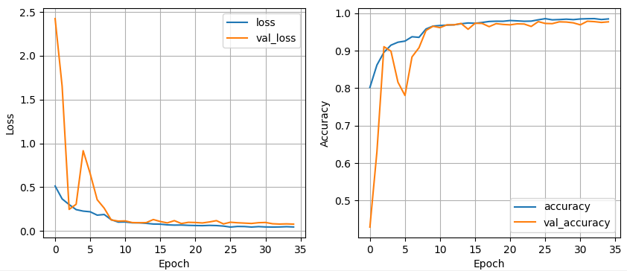
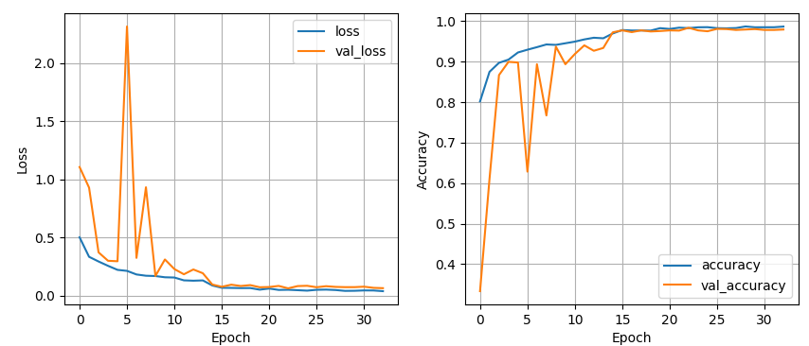
Conclusion
Fewer depth (123→103)
Fewer parameters (8,564,507→1306466 )
Shorter training time (2187sec→1462sec)
(-16.26%)
(-84.75%)
(-33.15%)
We managed to maintain the same performance with a thinner model,
while three of them were all evaluated excellent!
DenseNet121
Modified DenseNet-BC
Improved & Modified DenseNet-BC

Slide 31
8.
Reference

Slide 32
Reference
[1] https://www.kaggle.com/datasets/vijaykumar1799/face-mask-detection
[2] https://cloud.tencent.com/developer/article/1725581
[3] https://cloud.tencent.com/developer/article/1725581
[4] https://zhuanlan.zhihu.com/p/92134485

Slide 33
THANKS FOR LISTENING

